Slide 1
Group 5: Library Software

Slide 2




Joshua Charlesworth
Ricky Ip
Arsen Dzhuraev
Jordan Walker

Slide 3
Addition of Context into Design Architecture
In the design document, we decided to add a section providing context to certain design choices, such as the assumption that most interactions with this software will be done by the staff member, the only exception is searching library inventory.

Slide 4
Additional Module added to Document
The addition of the Network Communications module in order to specify the actions taken in order to have the client communicate with the server backend. This includes:
Specification about the required communication between the Staff (Client) and the Backend (Server).
Specifications about a ClientHandler that will aid in multithreaded client handling.
Inclusion of message types in order to optimize data processing.

Slide 5
Updated Design Elements
We determined since our SRS submission that there are some key design elements we had not considered and therefore had to be added to our previous design framework and those are the 4 Classes Elements that we have listed down below:
Client and Server Handling
There needs to be a multithreaded solution for our server to service multiple clients
Client GUI
The client will have a thread running a GUI for the librarian to use to handle all library functions
Considering a Message Class/Objects
We realized that our previous design was lacking a message class that will encapsulate data in order for it to be handed off between the client and the server.
The primary vehicle to handle the messages will be the ClientHandler
The message will use enums to determine the type of message along with other values to sort them to the correct places to be used by the server and vice versa back to the client
ClientHandler
The ClientHandler handles communication between the client and server, it possesses the message objects that will be handed between the client and server to move data, requests and answers between them
Notes:
Checking in/out - Basic Library functions
Transferring items - Since this is a network of libraries, efficient transfer of items between libraries is essential
Member vs Staff Support - Staff will extend the role of a member by being able to administrate accounts and books
Simple Gui - Allowing user to digitally explore the full library after logging in.

Slide 6
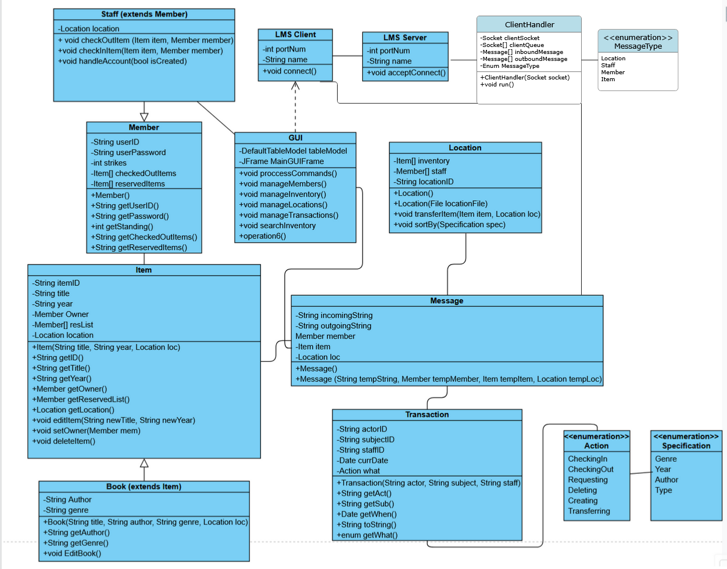
Finalized Class Diagrams

Slide 7
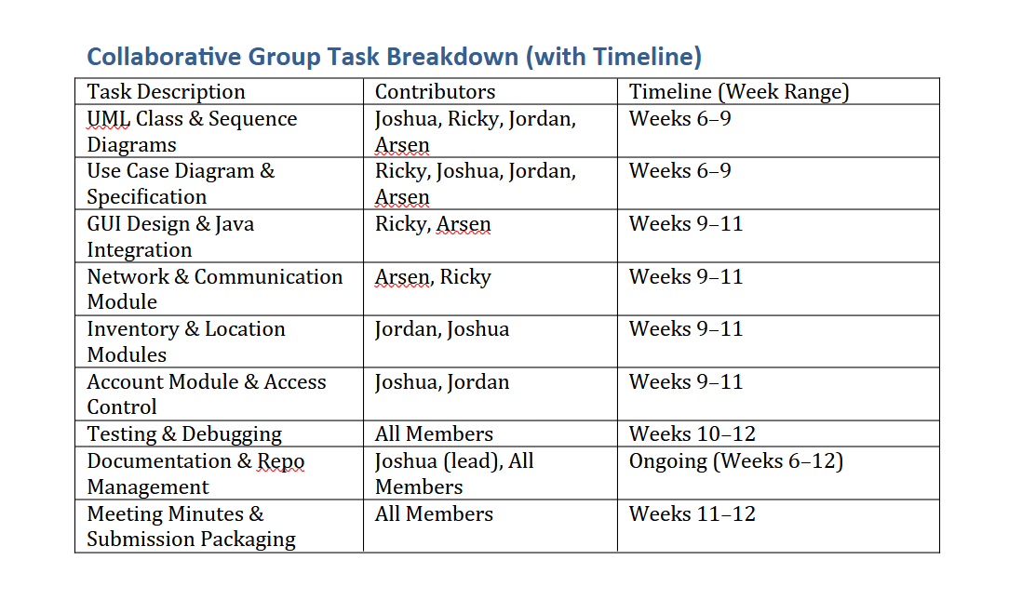
Preliminary Group Task and Workload Schedule

Slide 8
Thank you!
Questions or Suggestions?

